Slide 1
Herd manager

Slide 2
Why this app needed
For data management
For scientific management of farm
For providing economics of the farm
How it differs from other app
All apps providing only data management
But with help of this app we are going to provide the scientific management guidance and also importantly farm economics ( P&L analysis)

Slide 3
Who are all the targeted people
Farmers with reasonable herd size and running it as a business

Slide 4
How this app work
Farm owner/manager enter the required details on daily basis
App itself delivers certain data to the user ( Milk record, breeding record., etc) from the entered details
Economical details and scientific guidance delivered by admin on request/ or in specific time gap.

Slide 5
App and registration
Users can download it from play store
Register option should be given in login page
Upon successful registration and payment they will provided with login credentials

Slide 6
For new user
login
New cattle registration
Add feed / fodder inventory

Slide 7
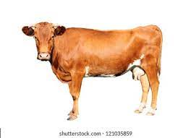
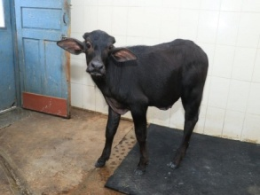
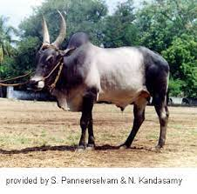
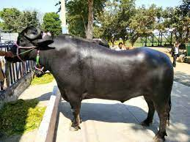
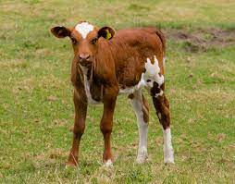
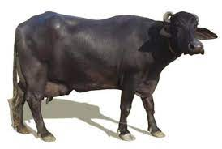
Add new cattle
Select type
If calves then dam should be tagged with that for identification
Tag no/ name of the animal -
Dob or age -
No.Of lactation
Milking Status of the animal - In milk / Dry
Breeding status of the animal - pregnant / bred/open
If pregnant date of last breeding -
Date of last calving
Calf details - male / female
Add feed
Roughage scroll down
Concentrate scroll down
Others scroll down ( gnc.csm., like)
Once successful animal registration navigated to updating breeding record

Slide 8

Xx dairy
30
15
5
8
No of animals
Cow in milking
pregnant milking
dry pregnant
non pregnant
Data captured from
animal registeration

Slide 9
Milk data registeration
Menu
milk data entry

Slide 10
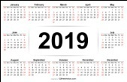
Milk data entry
Date :
Shift : morning / evening
List of animals in milking | QTY in Ltr | Fat % | SNF %
 | Total qty | Average fat % | Average snf %
( animal list captured from registration details)

Slide 11
Milk Report
date : shift :
Click here for animal wise milk data

Slide 12
Individual milk report
Select animal
From date to date
Morning | Evening | Total
Total milk yield :
Total no. of days ;
Average yield
Average fat%
Average Snf %
All datas taken from the milk data entry

Slide 13
Breeding record
Menu
Breeding record entry
Calving details entry
Insemination/pregnancy entry

Slide 14
Insemination details
Select animal - scroll down( list except preg)
Date of heat signs noted
Action bred /skipped
If bred following details needed
Date -----
Nature of the service - insemination/ natural
Name of the sire
Name of AI tech if insemination done
Set alert for pregnancy diagnosis and heat followup
After PD if result must be entered
General animal data base updated according to the breeding status change automatically

Slide 15
Calving details
Select the animal – scroll from pregnant animal list
Date of calving
Sex of the calf
Set alarm for deworming and routine farm analysis

Slide 16
Breeding report
Select animal
Date of last calving
Insemination details
Date of heat observed | Service / insemination date (if inseminated include name of AI tech) | Sire details | result
All data captured from entry)

Slide 17
Treatment record
Menu
Treatment entry
Vaccination entry
Deworming entry

Slide 18
Treatment entry
Select animal :
Date :
Diagnosis :
Medicines used : scroll down of medicines (we can give common medicine list)
provision also given for other medicines
Follow up advised :

Slide 19
Treatment record
Select animal :
From date to date
Date | Diagnosis | Treatment | Follow up

Slide 20
Vaccination entry
Select animal - options to select multiple animals
Vaccine - select from scroll down
Date -
Alert set - remind after days

Slide 21
Vaccine record
Select animal
Vaccine | Last vaccinated on | Due date

Slide 22
Deworming entry
Select animal - options to select multiple animals
Dewormer - select from scroll down qty
Date -
Alert set - remind after days for next deworming

Slide 23
Deworming record
Select animal
Next due date
Date | Medicine used

